Slide 1
SPEECH RECOGINITION SYSTEM BY CORELATION METHOD
2016_CS_158
2016_CS_178

Slide 2
AGENDA
Corelation Method:
To understand this method corelation very well and implement it in matlab by mathematical calculations.
SECURITY SYSTEM :
To build a good security system by this technique “Corelation”.

Slide 3
Develop a relationship between two voices
This is the main task of our project to develop a relationship between two voices that’s how we can compare two voices in our system.
Both ,the content of audio and the voice itself is the most important part of system because of them we can verify the person.

Slide 4
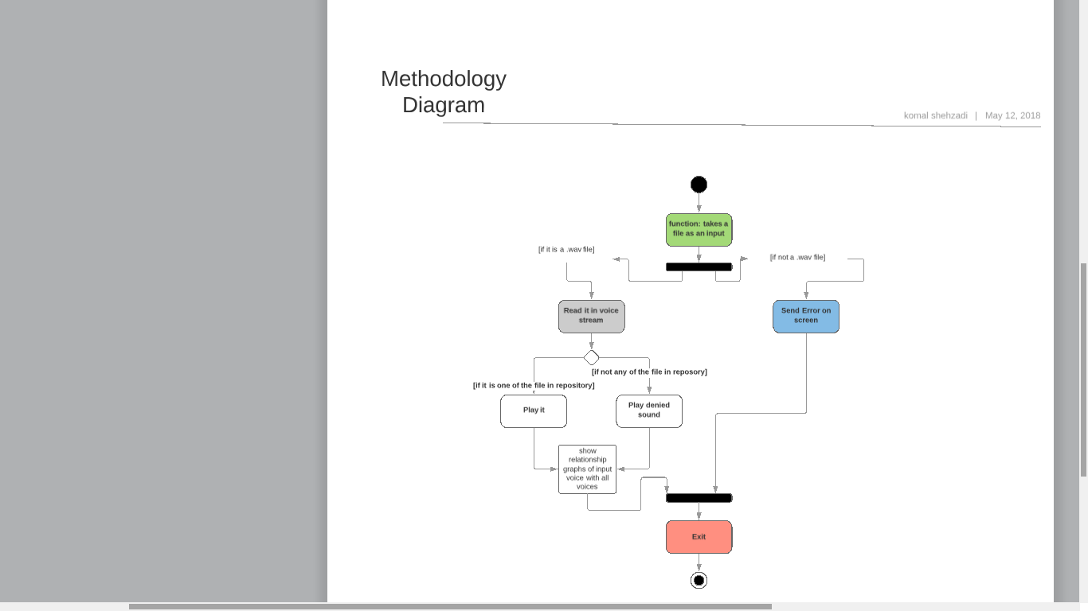
Methodology Diagram

Slide 5
Demo Video
https://drive.google.com/open?id=1cx8dI565JihGj4pabpigJbagecnDhxHE

Slide 6
Results
Our system is working perfectly fine. We have to pass a audio.wav file as a formal parameter to our function and it will give the precise result.

Slide 7
References
https://www.globalme.net/blog/speech-recognition-software-history-future
https://www.theengineeringprojects.com/2016/02/speech-recognition-using-correlation-matlab.html
https://pdfs.semanticscholar.org/190c/22e127a824bceaf18b8cbda79d4acee549a4.pdf
https://en.wikipedia.org/wiki/Cross-correlation
https://www.doityourself.com/stry/4-different-types-of-security-systems

Slide 8
Any Questions?

